Slide 1
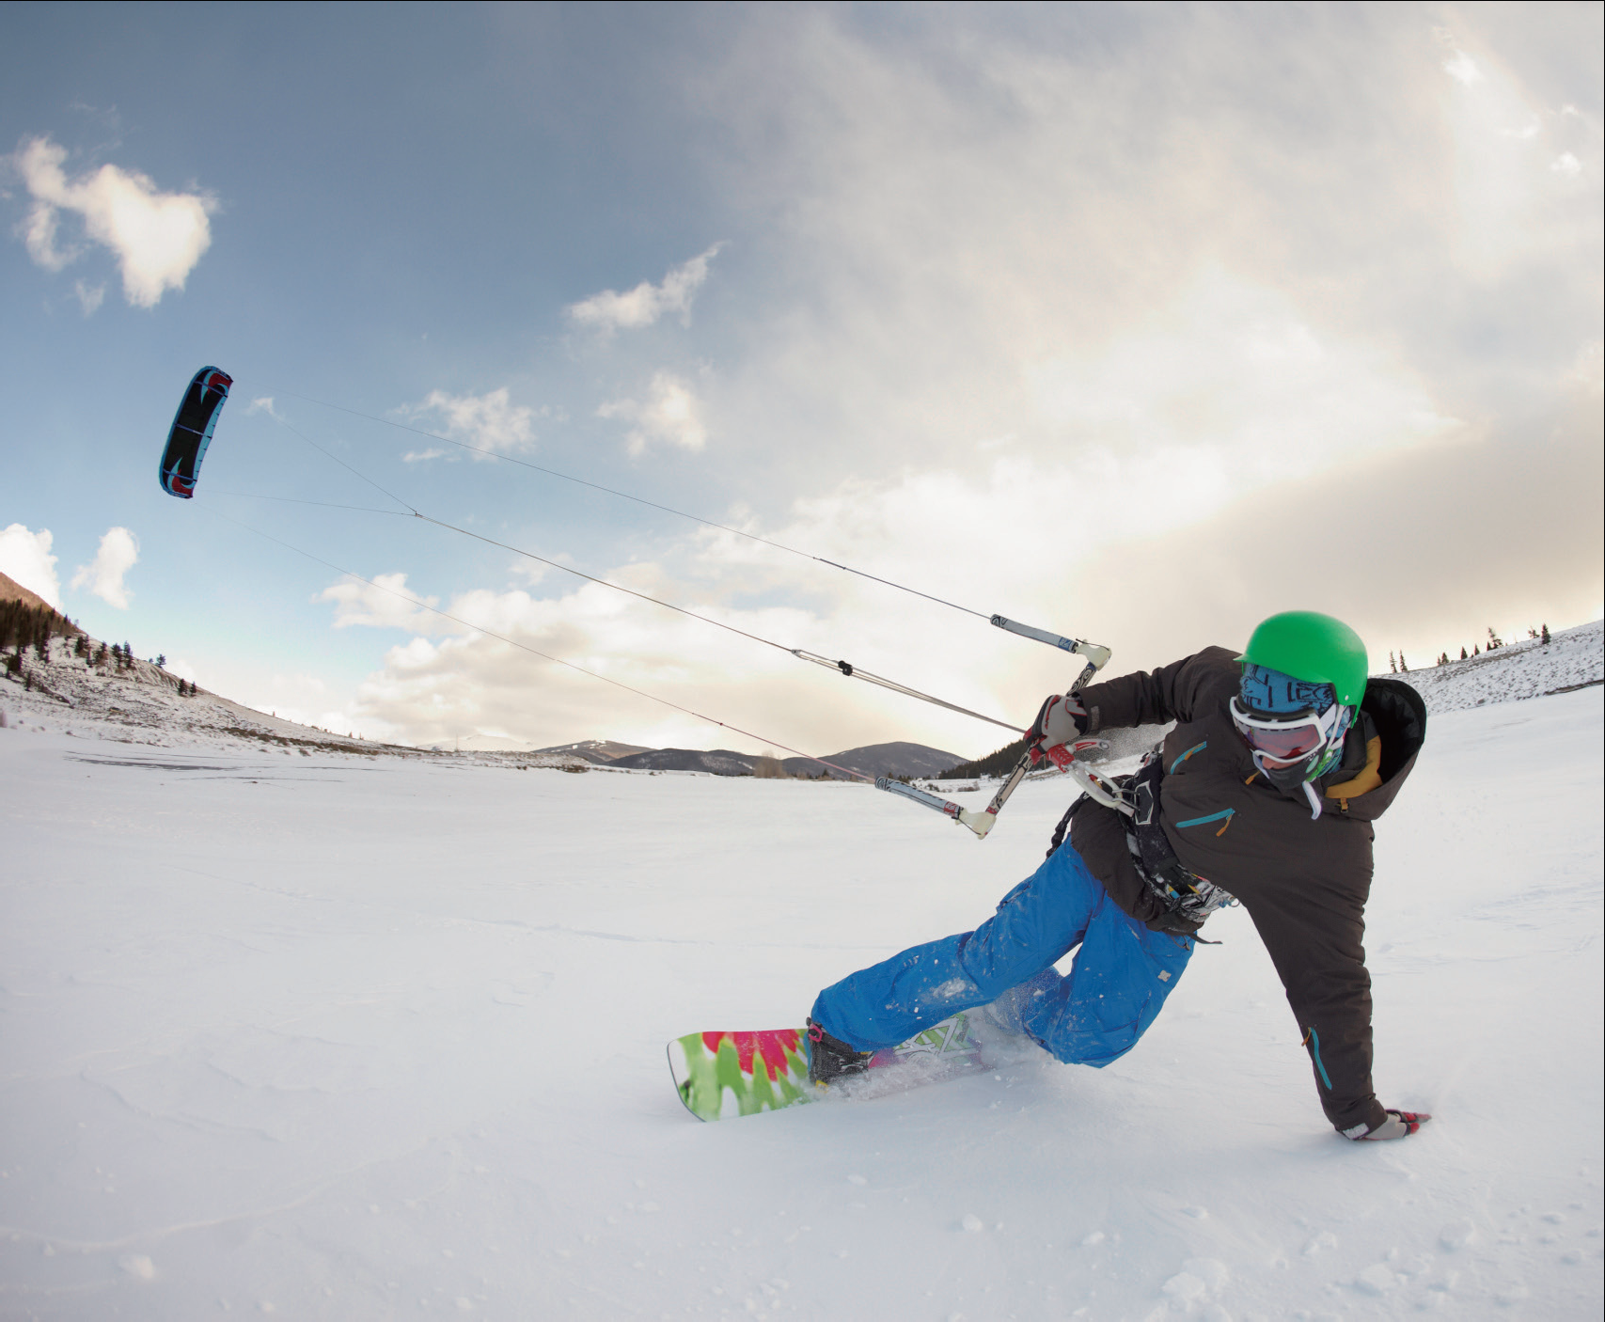
UNIT 2
A break for fun

Slide 2
Unit 2 A break for fun
Learning objectives
Opening up
Listening to the world
Speaking for communication
Further practice in listening
Wrapping up
Fun time

Slide 3

Learning objectives
1
talk about various leisure activities
2
identify words and expressions for describing people’s appearance
3
ask for and give recommendations
4
describe an event

Slide 4
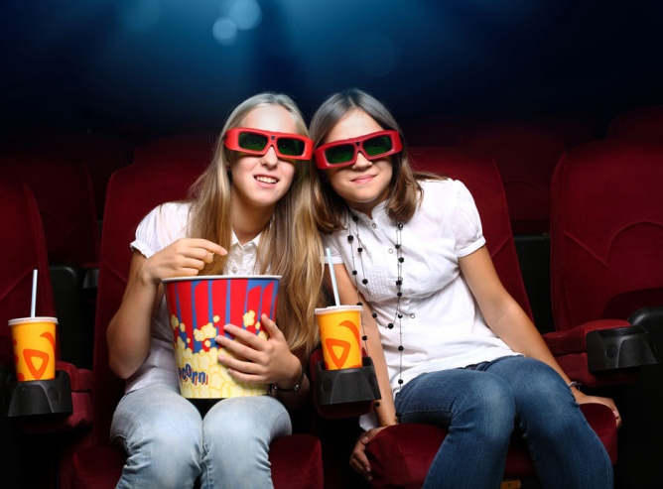
Opening up
1
Read the statements. Then underline the alternatives which are true for you or fill in the blanks according to your own experiences.
1 I go to the cinema about once a month / every two months / ____________.
2 I prefer romantic / action / _________ films.
3 I prefer going to the cinema
only by myself / with my friends.
4 I love pop / classical / ________
music.
every week
comedy
jazz

Slide 5
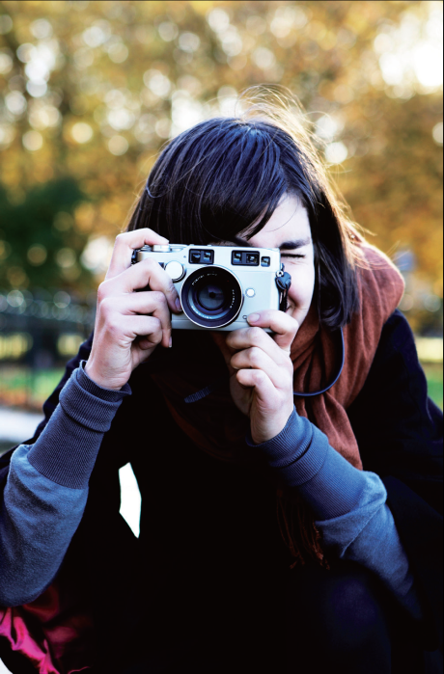
Opening up
1
Read the statements. Then underline the alternatives which are true for you or fill in the blanks according to your own experiences.
5 I love to participate in / seldom go to campus festivals of all kinds.
6 I often go to concerts / see plays / see operas / ____________.
7 I take photos every day / only at special events / on holiday.
8 My favorite subjects of photos are people / buildings / nature / ____________.
see musicals
animals

Slide 6
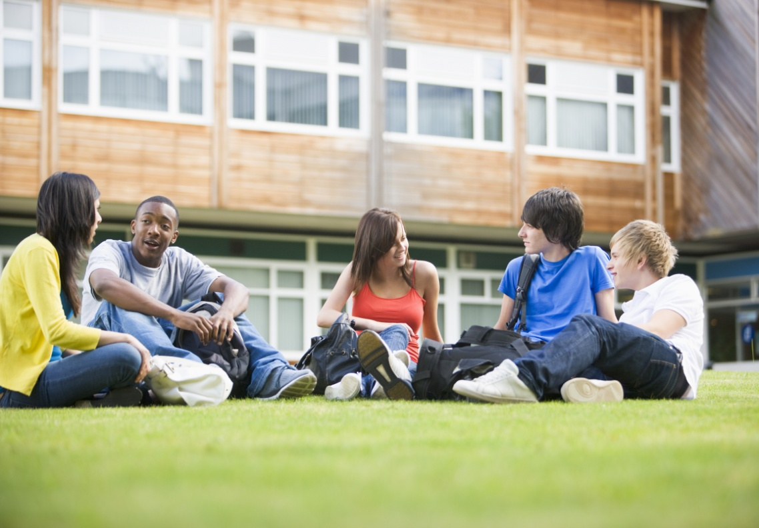
Opening up
2
Work in pairs and compare your answers.

Slide 7
Listening to the world
Sharing
Listening
Viewing

Slide 8
Listening to the world
Sharing
1
Watch a podcast for its general idea.
The people in the podcast mainly talk about how often they go to the cinema and what films they saw last time. They also talk about their favorite films, actors, and actresses.
2
Watch Part 1 and fill in the blanks.
once a month
Not very often
once or twice
once a week
once every month
every fortnight

Slide 9
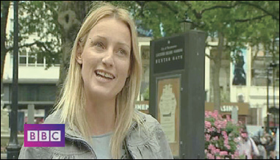
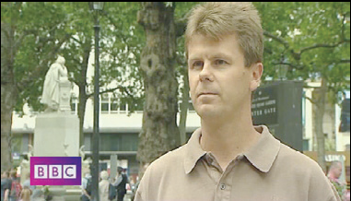
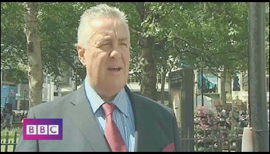
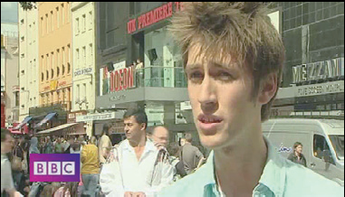
Listening to the world
Sharing
3
Watch Part 2 and fill in the blanks.
romantic
great
3) recommend
4) action
A
B
5) collection
6) real life
7) scenes
8) fantastic
C
D

Slide 10
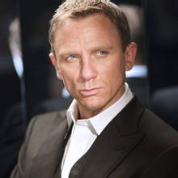
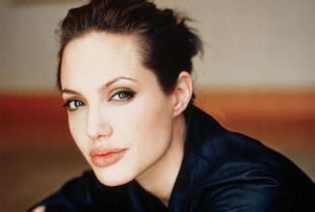
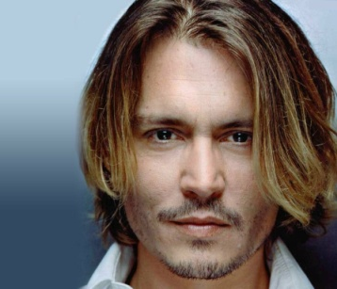
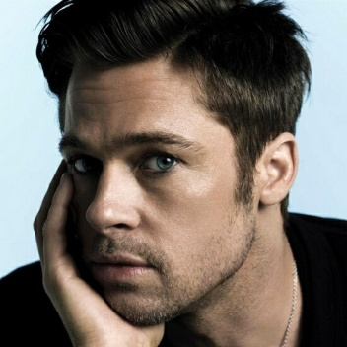
Listening to the world
Sharing
4
Watch Part 3 and match actors / actresses 1-4 to the people’s comments a-d.
c very good at showing emotions
d very beautiful and playing lots of different roles in films
1 Daniel Craig
2 Angelina Jolie
a funny and lively
b very good-looking and talented
3 Johnny Depp
4 Brad Pitt

Slide 11

Listening to the world
Sharing
4
Watch Part 3 and fill in the blanks.
Additional Notes
Australia a historical romance movie released in 2008. In the movie, Nicole Kidman plays an English aristocrat ( 贵族) who inherits a huge ranch ( 大牧场) in Australia, and Hugh Jackman plays the cattle driver who helps protect her property. As they try to drive their cattle across the country, they witness the bombing of Darwin ( 澳大利亚达尔文军港) by Japanese forces.

Slide 12
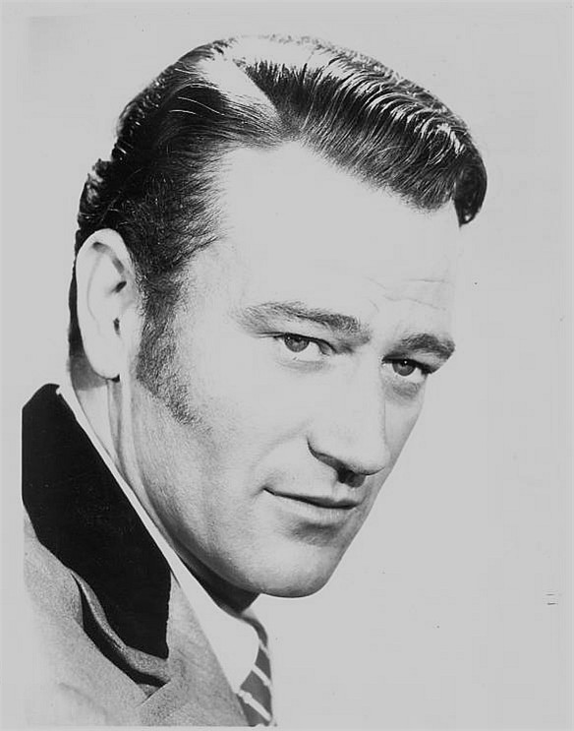
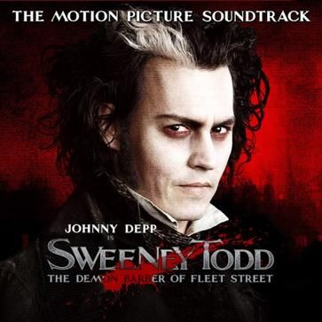
Listening to the world
Additional Notes
John Wayne an American film actor, director and producer, and an Academy Award winner. | Sweeney Todd a horror musical film released in 2007. The film tells the tale of Sweeney Todd, an English barber and serial killer who murders his customers.

Slide 13

Listening to the world
Sharing
5
Discuss the questions.
1 What is your favorite film? Why?
My favorite film is The Graduate. I like the movie because the music is fantastic. And I enjoy Dustin Hoffman’s great performance.

Slide 14
Listening to the world
Sharing
5
Discuss the questions.
2 Which do you prefer, watching DVD movies at home or going to the cinema? Why?
I prefer going to the cinema because it provides better sound effects. Besides, with more people around, the atmosphere is much better than when I watch movies alone at home.

Slide 15
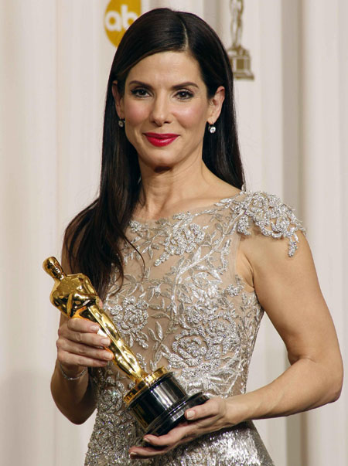
Listening to the world
Sharing
5
Discuss the questions.
3 Who are your favorite actors and actresses? Why do you like them?
My favorite movie star is Sandra Bullock. I like her because she is beautiful and her performance is natural. I love her warm smiles as well. Every time I see her smile,
I couldn’t help smiling too.

Slide 16
Listening to the world
Sharing
Listening
Viewing

Slide 17
Listening to the world
Listening
BEFORE you listen
1
Listen to Part 1 and answer the question.
The program is about ideas of beauty.
2
Read the information below. Then listen to Part 1 again and underline the words you hear.
blonde
blue
dark
masculine

Slide 18
Listening to the world
Listening
Listening skills
Identifying words and expressions for describing people’s appearance
Additional Tips
People’s appearance | Expressions
face | round, oval, square, with wrinkles / freckles, pale
clothes | casual, tidy, messy, shabby, stylish, old-fashioned, fashionable
facial expression | happy, excited, sad, tired, upset, curious, dark, thoughtful, worried

Slide 19
Listening to the world
Listening
Listening skills
People’s appearance | Expressions
manners | graceful, polite, elegant, well-mannered, ill-mannered
personality | bad-tempered, friendly, easy-going, introverted, extroverted, shy, cruel, mean, open-minded, outgoing, good-tempered
intelligence | intelligent, bright, clever, dumb, stupid, smart, wise

Slide 20
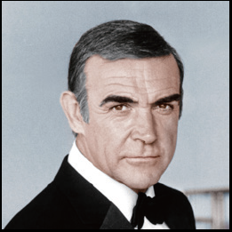
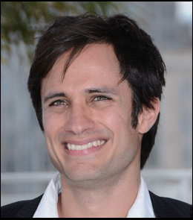
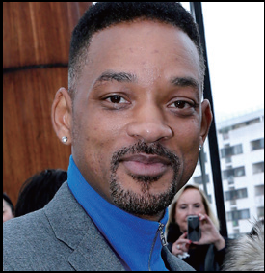
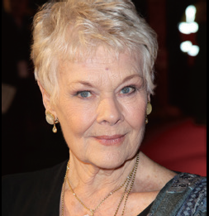
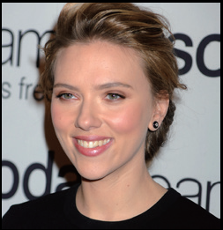
Listening to the world
Listening
WHILE you listen
3
Listen to Part 2 of the radio program. Then match the people to the film stars they like.
Woman 1
Woman 2
Man 1
Man 2
Sean Connery
Gael Garcia Bernal
Will Smith
Judi Dench
Scarlett Johansson

Slide 21
Listening to the world
Listening
WHILE you listen
4
Read the table. Then listen to Part 2 of the radio program again and complete the table.
tall
masculine face / best-looking
black hair
dark brown
red hair
grey
slim
blonde hair
lovely

Slide 22
Listening to the world
Listening
After you listen
5
Discuss the questions.
1 What is your personal preference about people’s appearance? What is your idea of beauty?
The man I like should be strong and fit, without a beard. The woman I like most is someone who is slim and healthy.
Beauty is what we see and feel. So my idea of beauty is what is pleasing to the eyes. As long as it makes you feel good, it is beauty. So both inner qualities and body features are important factors to make one look beautiful.

Slide 23
Listening to the world
Listening
After you listen
5
Discuss the questions.
2 Do you think ideas of beauty in China are changing? Why?
The ideas of beauty have changed over the past several decades in China. Truly, on the one hand, many still stick to the idea that one’s inner quality counts more than outer appearance. On the other hand, more and more people think outer appearance is more important.

Slide 24
Listening to the world
Listening
After you listen
5
Discuss the questions.
3 Is it wise to judge a person by his / her appearance? How do you understand the proverb “Never judge a book by its cover”?
I don’t think it is wise to judge a person by his / her appearance because appearance is superficial. Sometimes the appearance of a person may mislead your judgment.
The greatness of a book lies in its content instead of its cover. So it is with a person.

Slide 25
Listening to the world
Sharing
Listening
Viewing

Slide 26
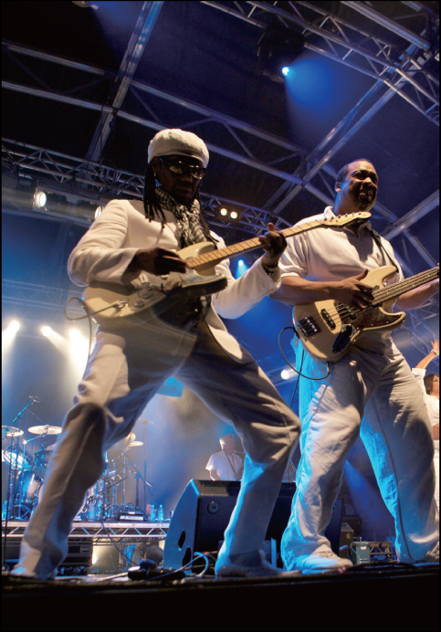
Listening to the world
Viewing
BEFORE you view
1
Read the program information and answer the questions.
1 What is Bestival?
A music festival
2 When and where is it held?
It is held in the Isle of Wight every September.
3 What do you think people do at Bestival?
I think people can enjoy the music at the festival and have fun with their families and friends.

Slide 27
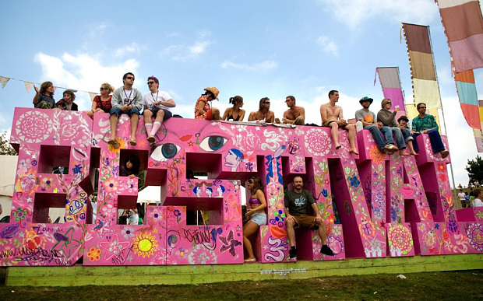
Listening to the world
Viewing
WHILE you view
2
Watch the video clip and check the reasons mentioned.
2, 4, 6

Slide 28
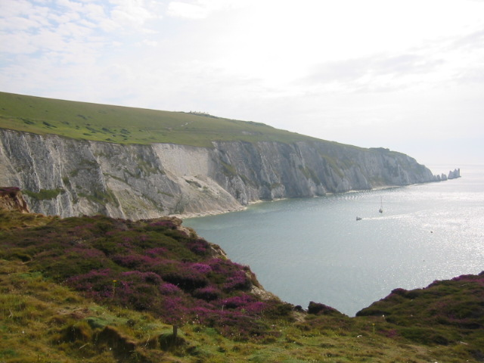
Listening to the world
Viewing
Additional Notes
the Isle of Wight a small island off the south coast of England. The island has a maritime ( 海事的) and industrial, and the testing and development of Britain’s space rockets. It has many traditional tourist attractions, and because of its attractive scenery, many annual festivals, such as Bestival, the Isle of Wight Festival, and the Isle of Wight International Jazz Festival are held there.

Slide 29
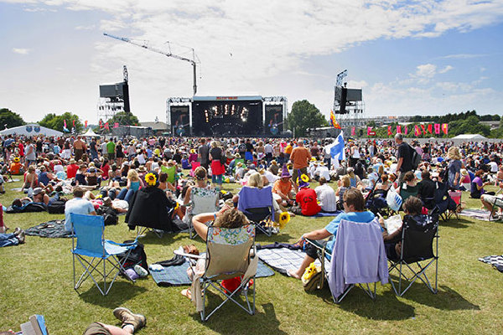
Listening to the world
Viewing
WHILE you view
3
Watch the video clip again and fill in the blanks.
1 garden;
baby and wife
2 traditional values;
likes
3 being together

Slide 30
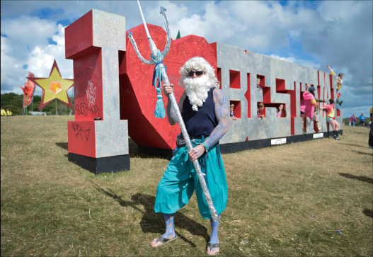
Listening to the world
Viewing
AFTER you view
4
Discuss the questions.
1 What do you think about Bestival? Would you like to go to a festival like Bestival? Why or why not?
Bestival seems a fun festival. People, young and old, can gather together, enjoy themselves, and forget about their worries.
I would like to go to a festival like Bestival because I like to be outdoors, listen to music, and do activities with other people. Most important of all, I enjoy spending time with my family and my friends.

Slide 31
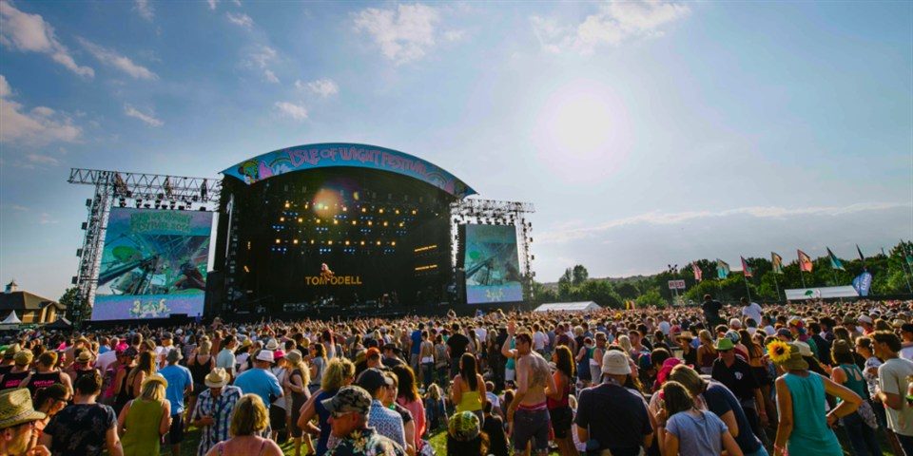
Listening to the world
Viewing
AFTER you view
4
Discuss the questions.
2 Of all the festivals held on your campus or in your city, which one do you like most? Why?

Slide 32
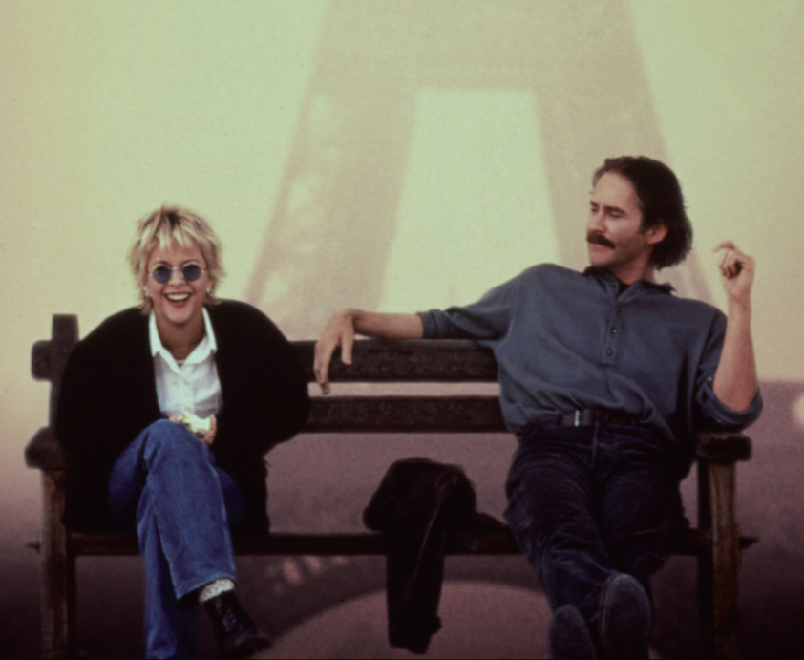
Speaking for communication
Role-play
1
Listen to Conversation 1 and fill in the blanks.
1) feel like
2) What do you recommend
3) how about
4) What’s it about
5) Who’s in it
6) Do you think
7) Why don’t we

Slide 33
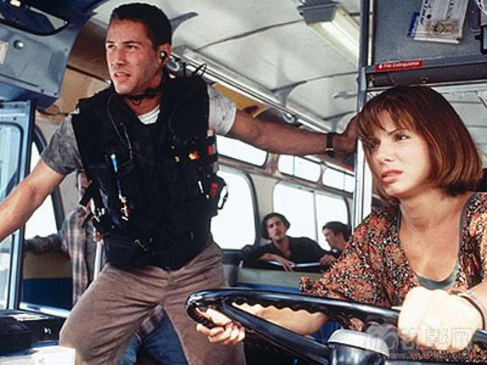
Speaking for communication
Role-play
2
Listen to Conversation 2 and check the ones you hear.
1, 4, 5, 7, 8, 9, 10.

Slide 34
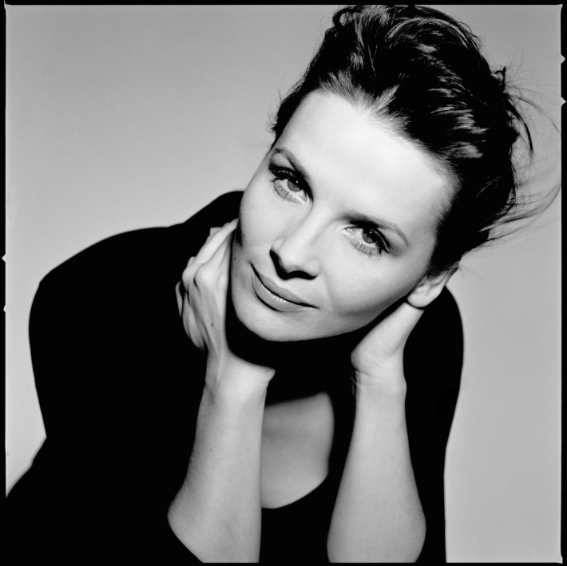
Speaking for communication
Role-play
Additional Notes
Juliette Binoche a French actress, artist and dancer. She has appeared in more than 40 films since 1983 and her great performances have won her many awards.

Slide 35
Speaking for communication
Role-play
Speaking skills
Additional Tips
Asking for and giving recommendations Here are some other ways to ask for and give recommendations.
Expressions for asking for recommendations: • Do you have any recommendations for …? • What would you do about ...? • I was hoping / wondering / thinking if …
Expressions for giving recommendations: • You might want to … • What I would do is to … • If I were you, I’d … • You could think about …

Slide 36
Speaking for communication
Role-play
Speaking skills
Additional Tips
Asking for and giving recommendations
Expressions for accepting recommendations: • That is a good recommendation. • That sounds like a good idea! / Great. / That’s very helpful. • Great. Sounds like the perfect place to go! • OK, why don’t we do that?

Slide 37
Speaking for communication
Role-play
3
Read the flowchart and fill in the blanks.
1) do you recommend
2) How about
3) What’s it about
4) Who’s in it
5) Do you think I’d like it
6) if you prefer
7) I think you’d like
8) Thanks for your recommendation

Slide 38
Speaking for communication
Role-play
4
Role-play the situations.
Situation 1
Finding a place for a birthday dinner
Student A
I plan to invite my friends to dinner. Do you have a nice place to recommend?
I know the food is good there, but it’s a bit too crowded.
That sounds perfect.
Student B
How about the Sichuan restaurant beside the university gate? The food is delicious there!
In that case, why not try the Sunset Restaurant? They have a large private room specially designed for activities like a birthday party.

Slide 39
Speaking for communication
Role-play
4
Role-play the situations.
Situation 2
Looking for a part-time job on campus
Student A
I’m thinking of doing a part-time job to cover some of my tuition fees (学费). What do you think I should do?
Well they are pretty good ideas. But I prefer to find a job that is related to what I’m learning.
That’s a great idea!
Student B
If you prefer to work on campus, you may get a job in the library.
Then you should work for a company. How about joining a translation company?

Slide 40
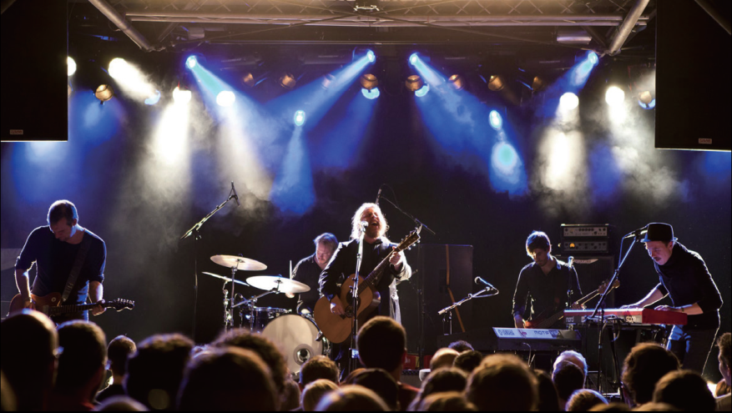
Speaking for communication
Group discussion
Get ideas
1
Listen to a woman talking about an event and answer the questions.
1 What was the event?
It was a free concert.
2 When and where was it?
It was held in the evening in City Park.

Slide 41
Speaking for communication
Group discussion
Get ideas
1
Listen to a woman talking about an event and answer the questions.
3 Whom did she go with?
She went with her boyfriend and some other friends.
4 What did they do in the afternoon?
They took a picnic and went out early in the afternoon. They got a place close to the stage. They chatted and lay in the sun.
5 What did she think of the event?
She thought the concert was fantastic.

Slide 42
Speaking for communication
Group discussion
Get ideas
2
Read the key expressions. Then listen to the talk again and underline the ones you hear.
1 Recently
2 in
3 We
4 a free concert
5 fantastic
6 really liked

Slide 43
Speaking for communication
Group discussion
Discuss and organize ideas
3
Work in groups of four. Share briefly with your group members a recent event you went to, e.g. a festival, a concert, a sports event, an exhibition, a play, a party, or a film.
4
Decide on one event your group would like to share with other classmates.

Slide 44
Speaking for communication
Group discussion
Discuss and organize ideas
5
Prepare for your talk. Take notes on the event and use the questions below as clues.
• What was the event?
• When and where was it?
• Why did you go there?
• What did you do or see?
• What did you think of it?

Slide 45
Speaking for communication
Group discussion
Present ideas
6
Present the event to the class. Before you begin, refer to the checklist below to see if you are ready.
Checklist
Provide enough details about the event.
Describe the event in an attractive way.
Use correct pronunciation.
Use eye contact and proper tone of voice when describing the event.

Slide 46
Further practice in listening
Short conversations
1 Q: Why didn’t the man go to the party?
D He had to handle something unexpected.
2 Q: What has the woman been preparing for?
B Writing a term paper on Hamlet.
3 Q: What does the man say about music?
C He doesn’t know how to appreciate music.
4 Q: What are the two speakers talking about?
A Their different college lives.
5 Q: What does the man mean?
D He thinks the scholarship is the result of the woman’s hard work.

Slide 47
Further practice in listening
Long conversation
Q1: Why is surfing the man’s favorite activity?
D Because it can help him forget all his troubles.
Q2: What is the woman going to do this weekend?
C To go to the beach.
Q3: What does the woman love doing?
B Enjoying the warm sun on the beach.
Q4: What does the man remember doing with his brothers?
C Building sand castles.

Slide 48
Further practice in listening
Passage 1
Q1: According to the survey, what percentage of British adults watched TV in their free time?
A 89 percent.
Q2: Which age group would be the most likely to visit their friends and relatives.
B People aged 25 to 34.
Q3: What does the speaker say about listening to music as a leisure activity for British people?
A People aged 16 to 24 preferred listening to music most.
Q4: According to the survey, how are leisure activities related to age?
C Older people spend more time reading and gardening.

Slide 49
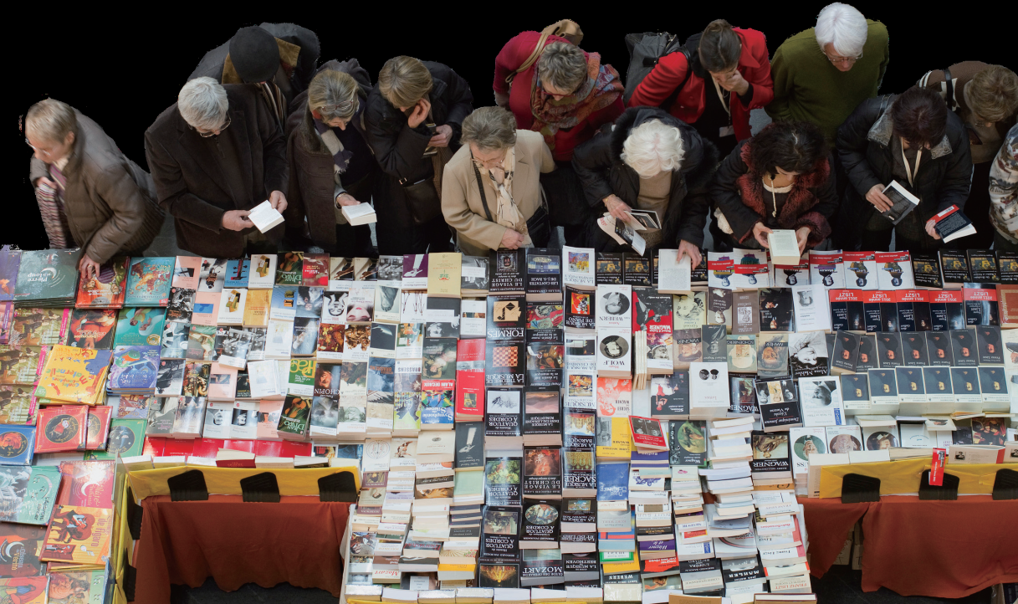
Further practice in listening
Passage 2
1) comic
2) traffic
3) constantly
4) available
5) took part in
6) attracted
7) audience
8) free of charge
9) put forward
10) embrace

Slide 50
Wrapping up
Use the following self-assessment checklist to check what you have learned in this unit.
 | OK | Needs work
I can talk about leisure activities.
I can identify words and expressions for describing people’s appearance in listening.
I can use proper expressions to ask for and give recommendations.
I can describe a past event in an organized and attractive way.

Slide 51
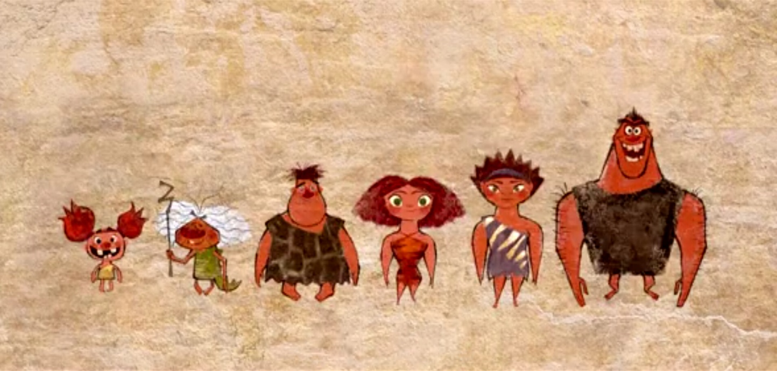
Fun time
Enjoy the video clip from The Croods.

